Slide 1
Predicting Household Income vs Expenditures
Week 3
The Topic: Household incomes and expenditures.
The Reason: The reason why we picked this topic is because today’s economy is crazy, and we want to see if we can predict how bad (or good) the economy will get in the next year.
Questions we hope to answer with Data:
What will the economy look like in one year?
Will the income and the expenditures both increase?
Will our model accurately reflect the economy for 2022?

Slide 2
Predicting Household Income vs Expenditures
Week 3
Description of the data phase of the project:
The data was found on a government website, under the topic "Economy"
Link:https://www.stats.govt.nz/large-datasets/csv-files-for-download/#:~:text=CSV%20files%20are%20text%20files%20with%20information%20separated,Microsoft%20Excel%2C%20the%20R%20statistical%20environment%2C%20or%20Python.
This data includes household income and expenditures such as rent, gas, bills, etc
Description of the analysis phase of the project:
The dataset contained income and expenditures from 2008 - 2022
We extracted a four year range from 2019 – 2022
Using 2019 - 2021, our goal was to build a model, which would accurately predict the income and expenditures for 2022

Slide 3
Technology, Tools, and Algorithms used for the project:
Excel for viewing the initial data
Pandas/Python for cleaning and transforming the data
SQL for building our database and creating additional CSV files
Machine Learning to build our LSTM Regression Model
Tableau for visualizations

Slide 4
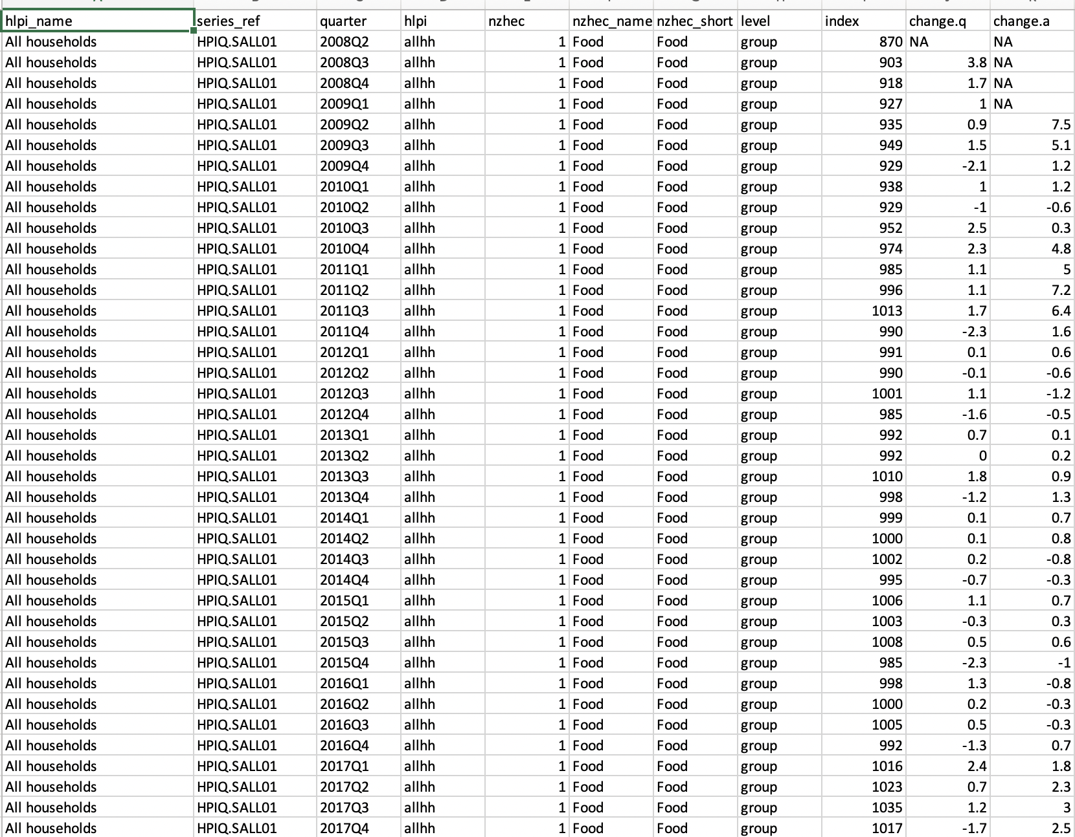
Excel: Viewing the raw data
Used Excel to examine the raw data
2
3

Slide 5
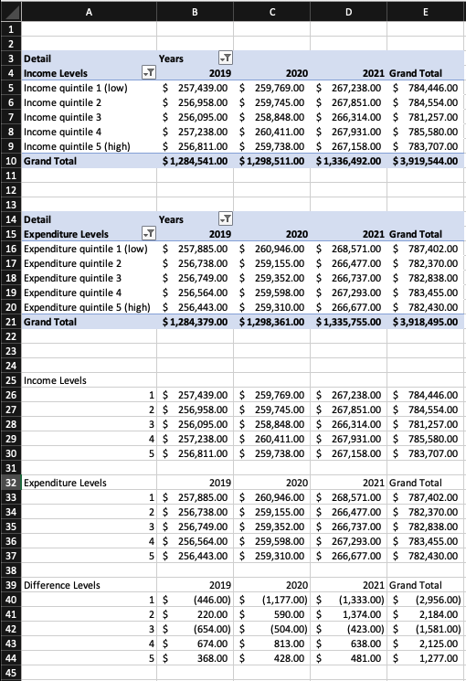
Excel: Pivot Tables
1
Pivot tables were used to filter data to better understand dataset
3

Slide 6
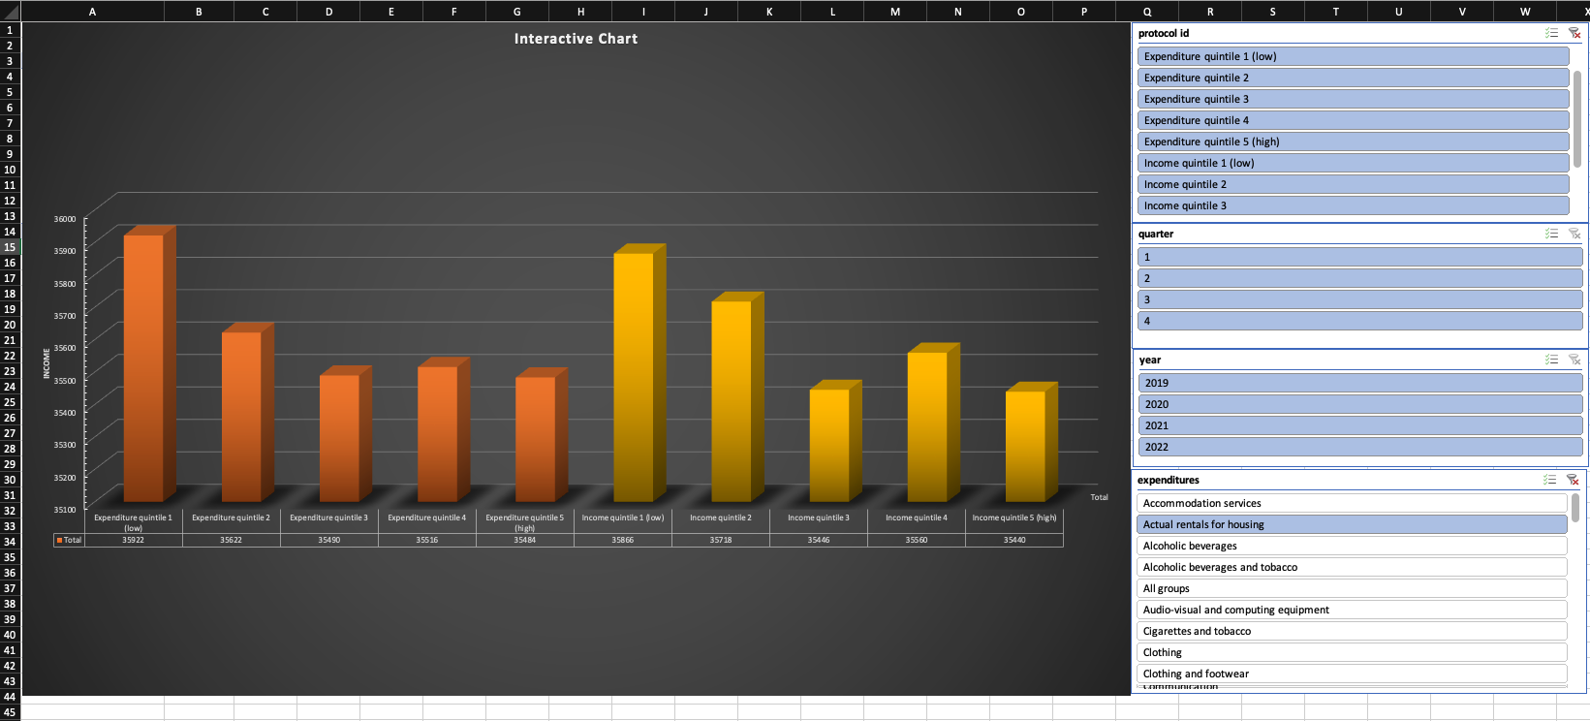
Excel: Graphs
1
2
Graphs were used to help visualize the data

Slide 7
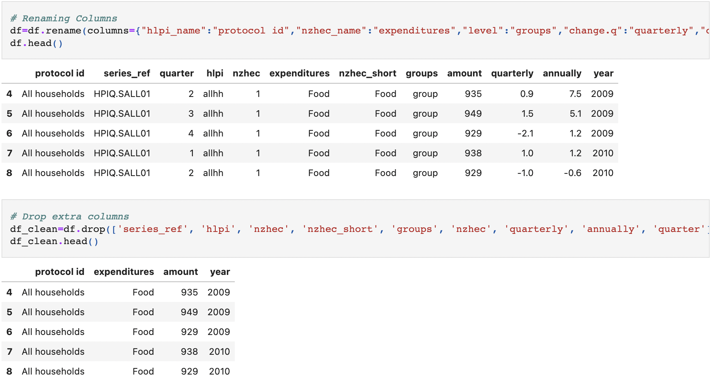
Python/Pandas: Renamed/Removed Columns
Dropped irrelevant columns not needed for our analysis
2
3
4

Slide 8
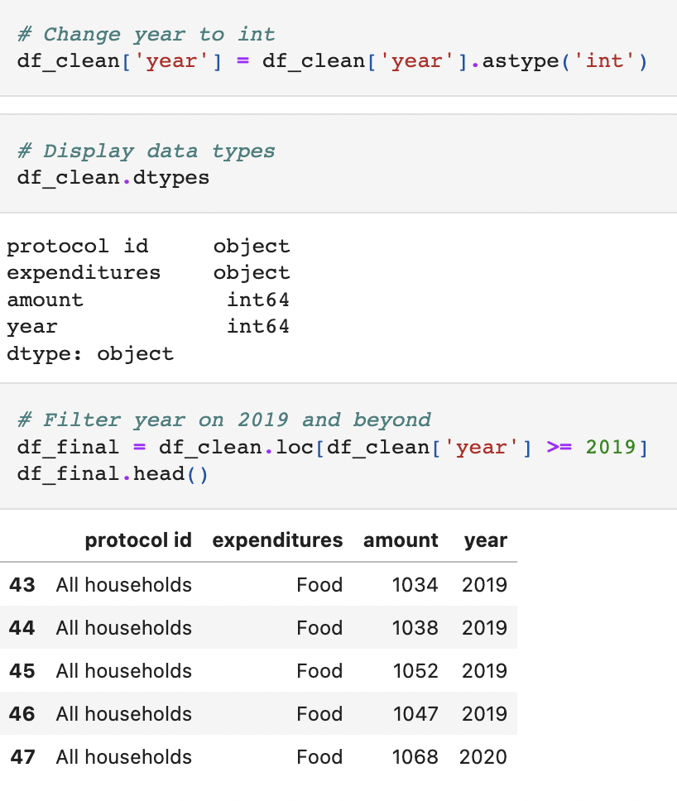
Python/Pandas: Changed data type and filtered on years
1
Narrowed down the dataset to capture 2019 and beyond in preparation for the machine learning model
3
4

Slide 9
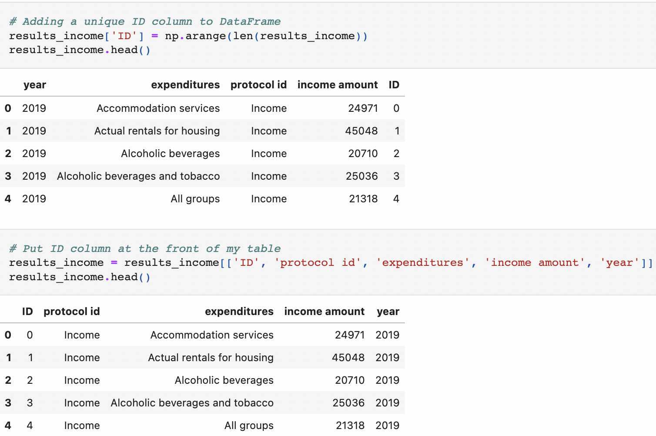
Python/Pandas: Added a Primary Key
1
2
Created a unique ID to link the tables in SQL
4

Slide 10
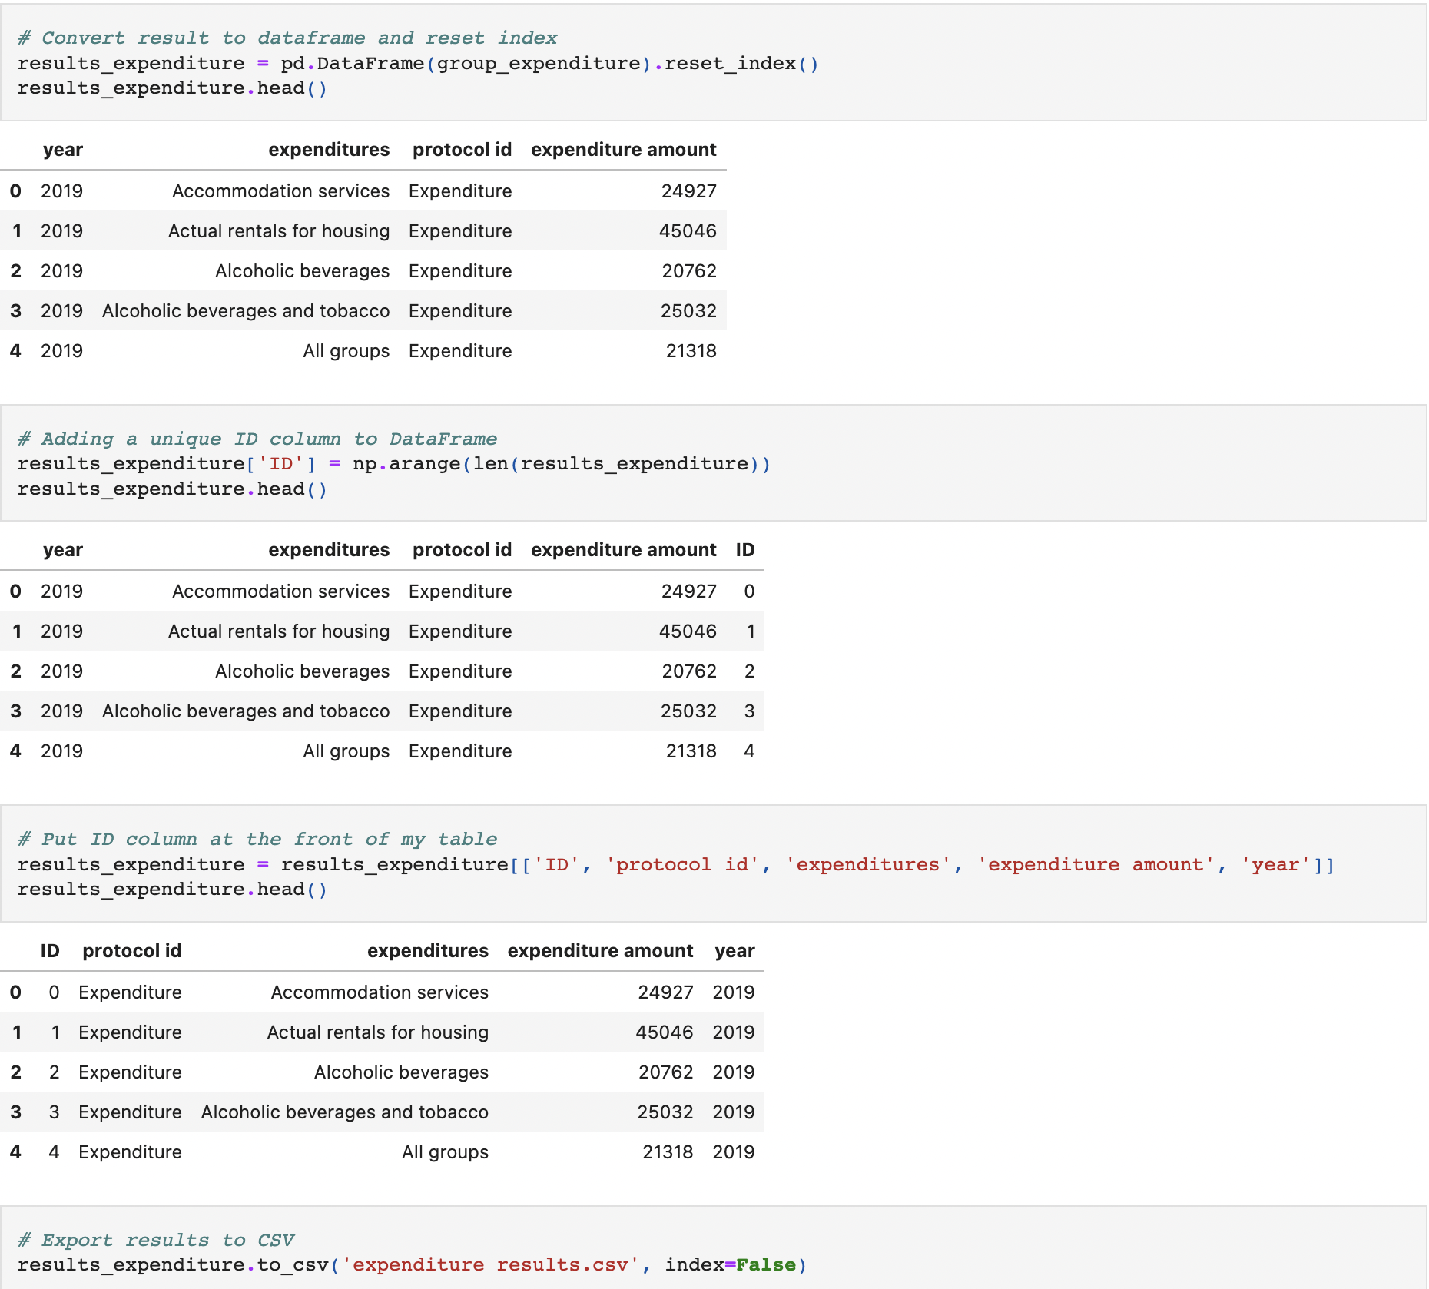
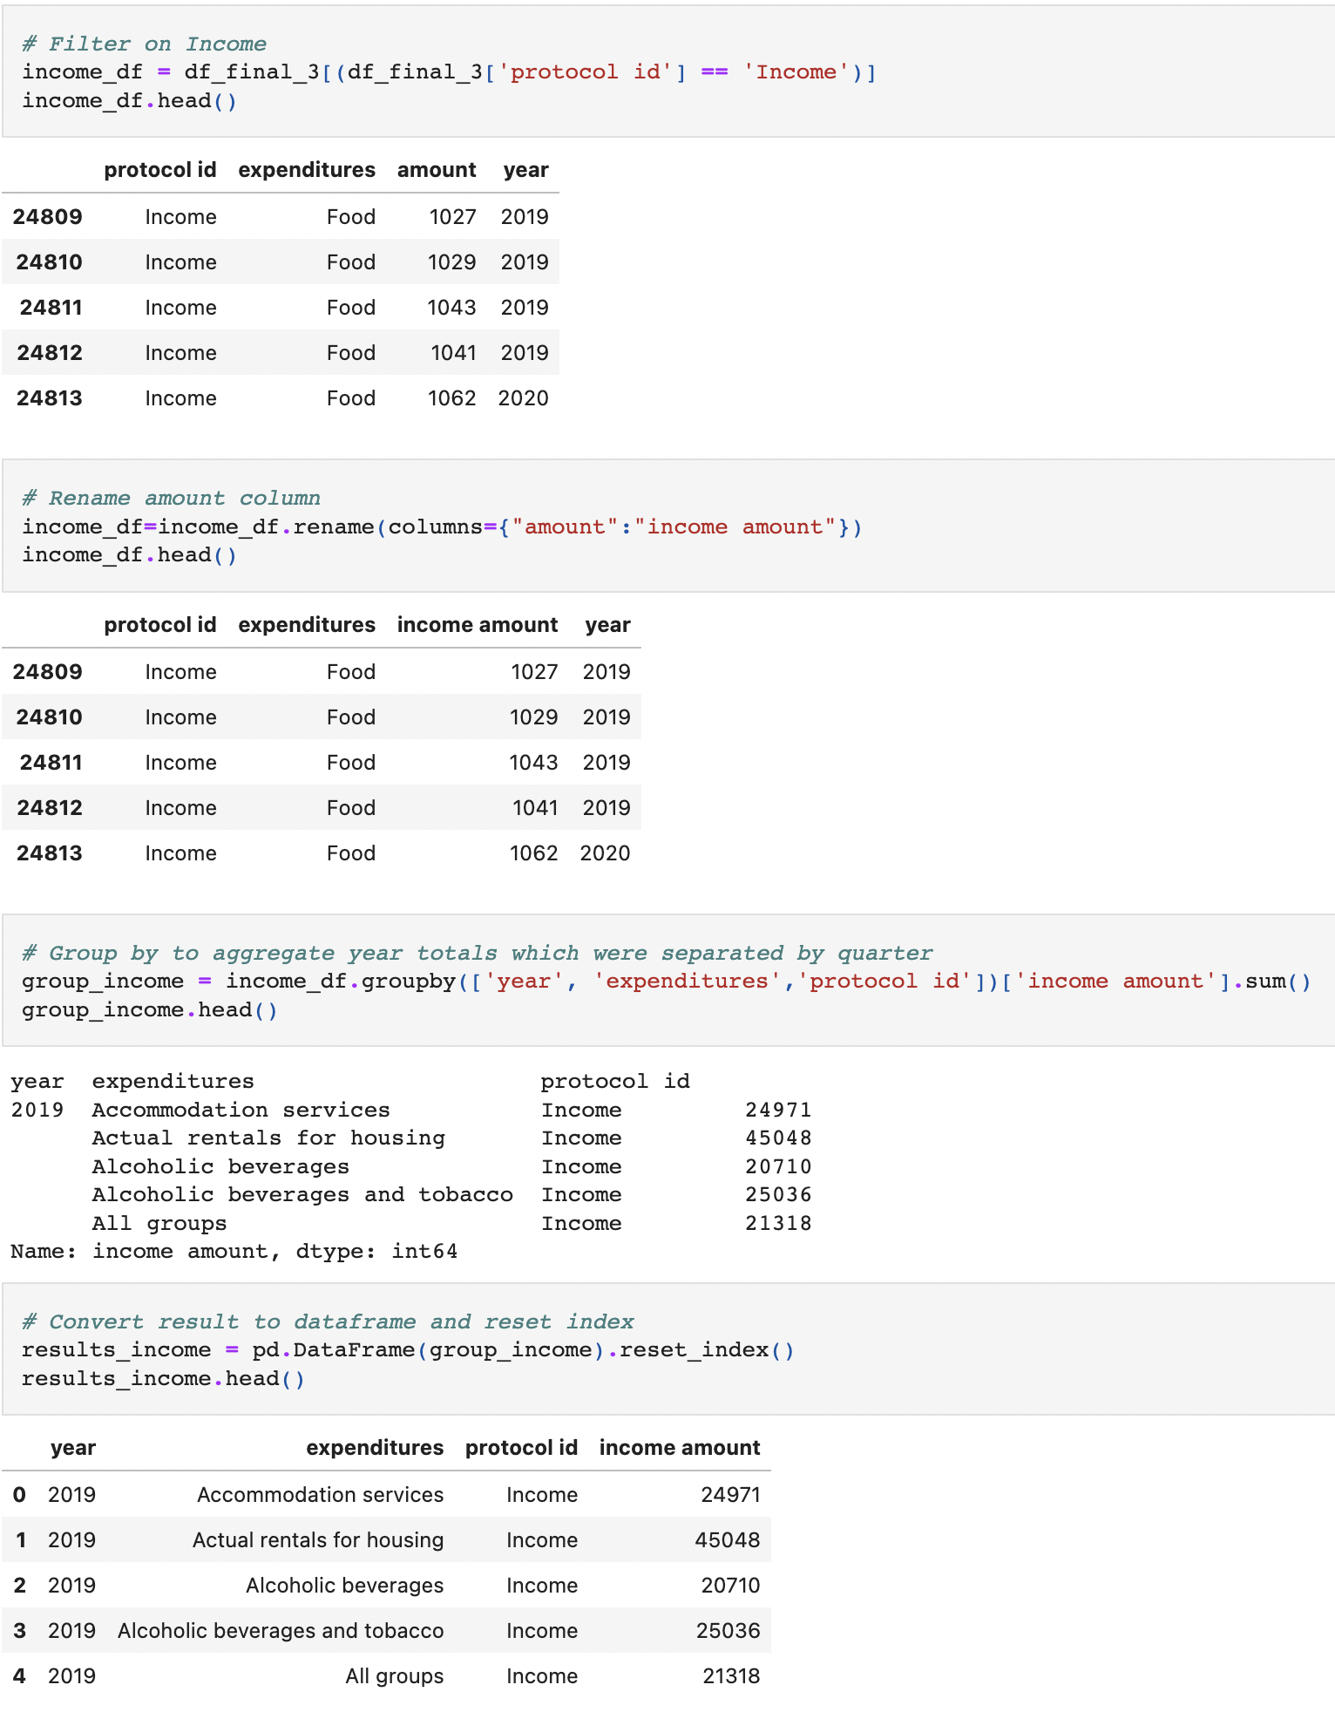
Python/Pandas: Created Income and Expenditure Data Frames
1
2
3
Created two data frames to build CSV’s for our SQL Database

Slide 11
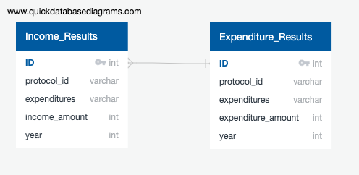
SQL: Created an ERD
Made an ERD to give us a foundation for our SQL tables
2
3
4

Slide 12
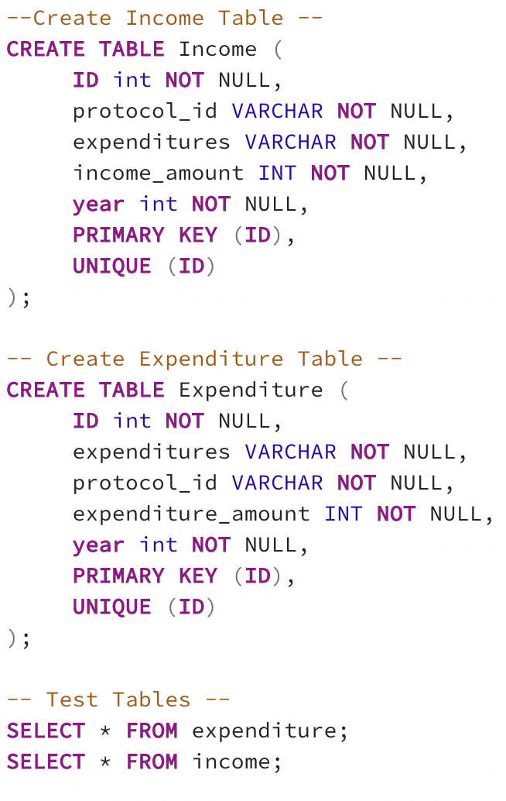
SQL: Built tables for Income and Expenditure files
1
SQL code to build our initial tables
3
4

Slide 13
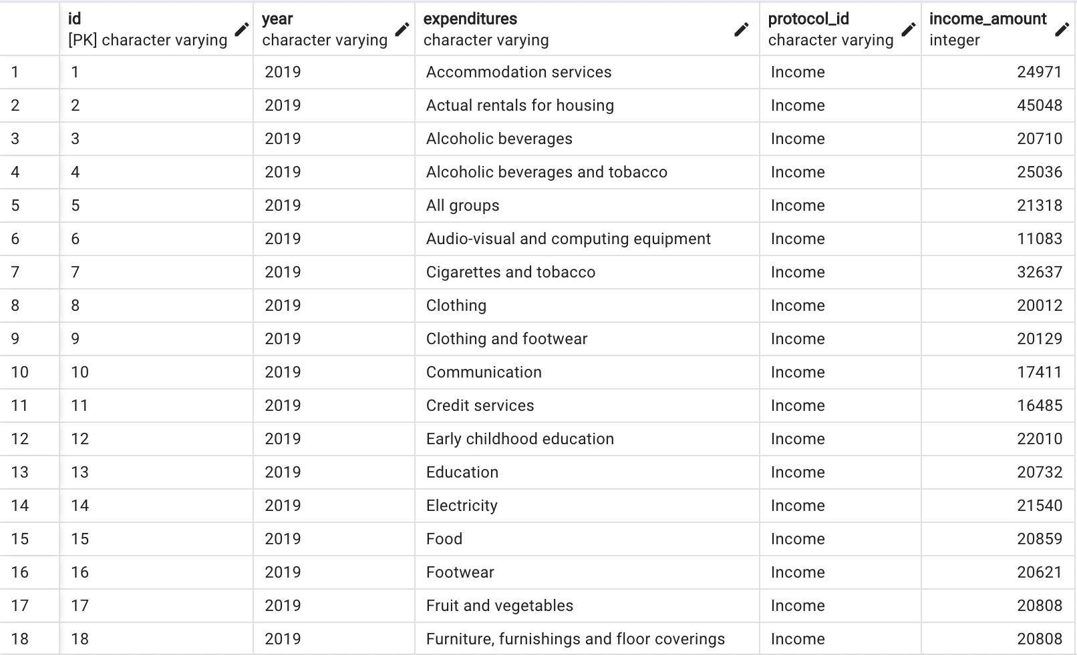
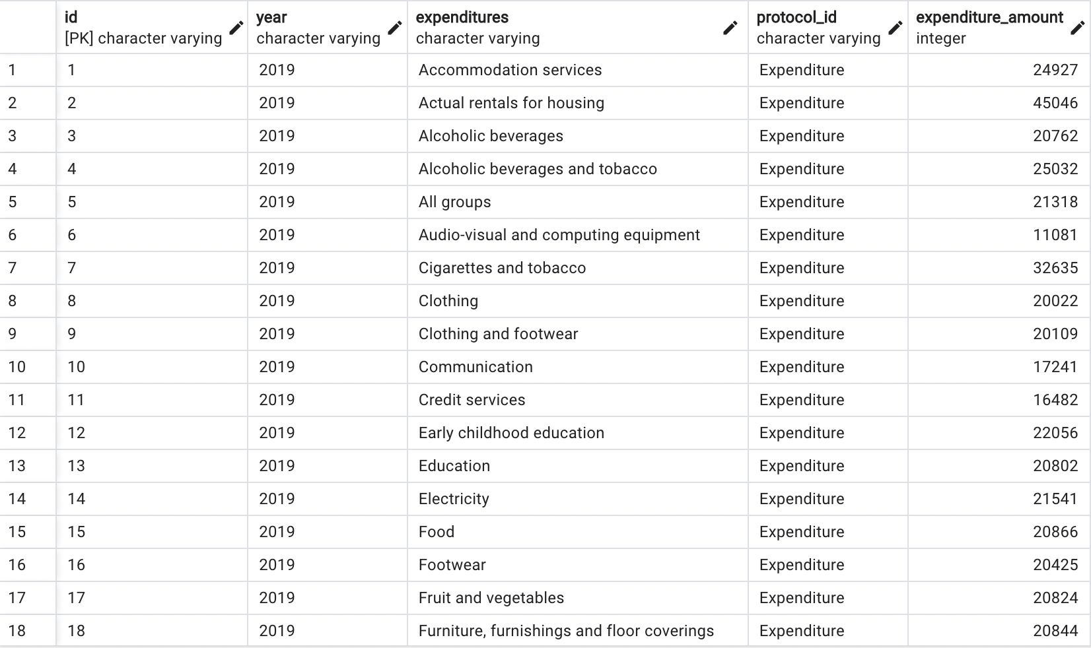
SQL: Income and Expenditure Table
1
2
Display Income and Expenditure tables in SQL
4
Income Table
Expenditure Table

Slide 14
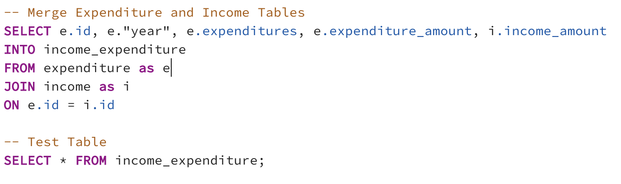
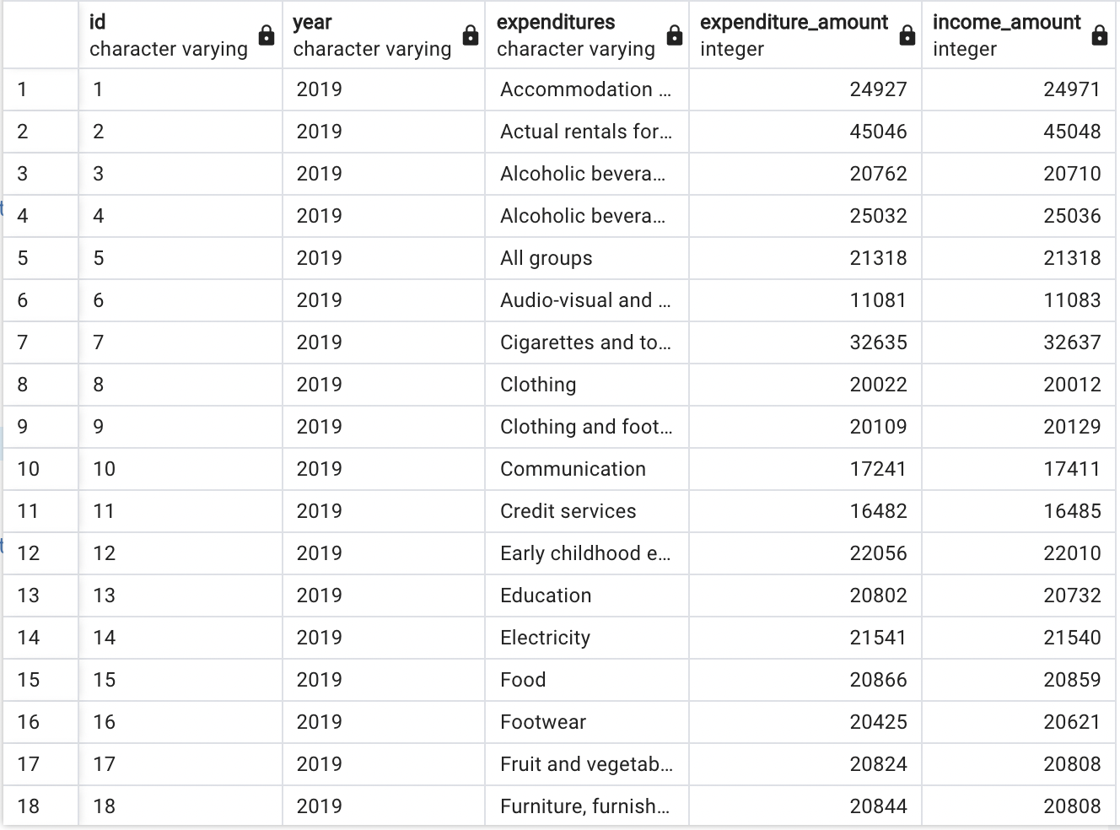
SQL: Merged the tables
1
2
3
Merged the two tables to create our final table to use in our analysis

Slide 15
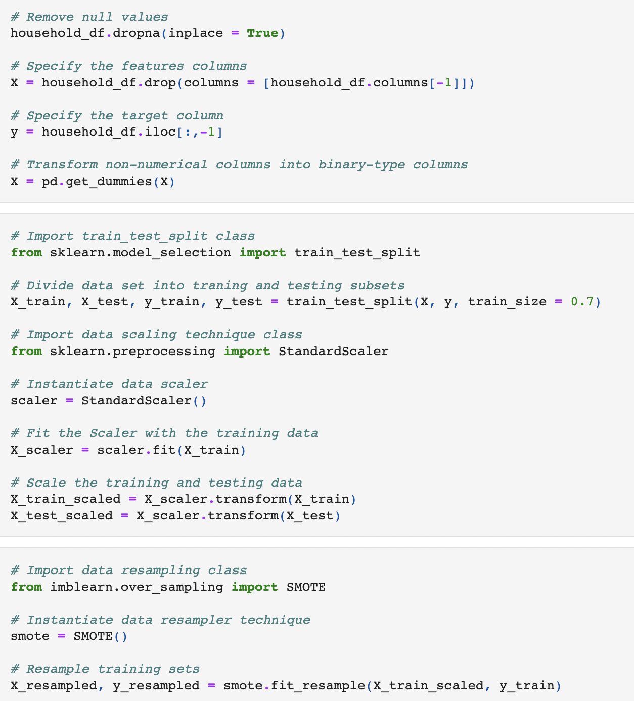
Machine Learning: Mock-Up Training and Testing
After reading in the data, we started training and testing our data, in addition to using SMOTE for resampling
2
3
4

Slide 16
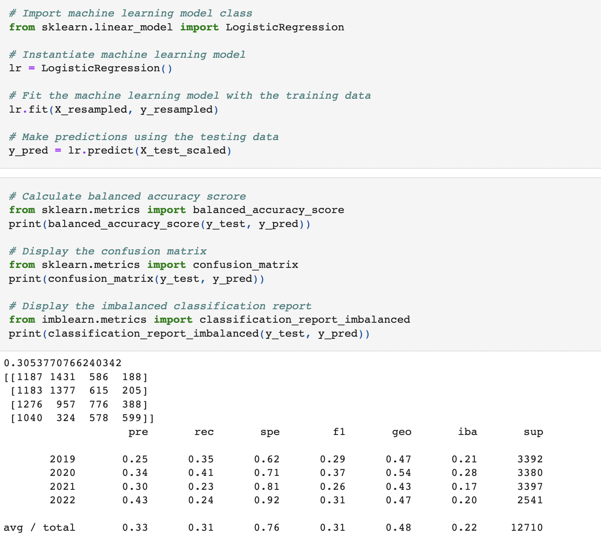
Machine Learning: Mock-Up Algorithm and Scores
1
Imported Logistical Regression Model to perform calculations and display results
3
4

Slide 17
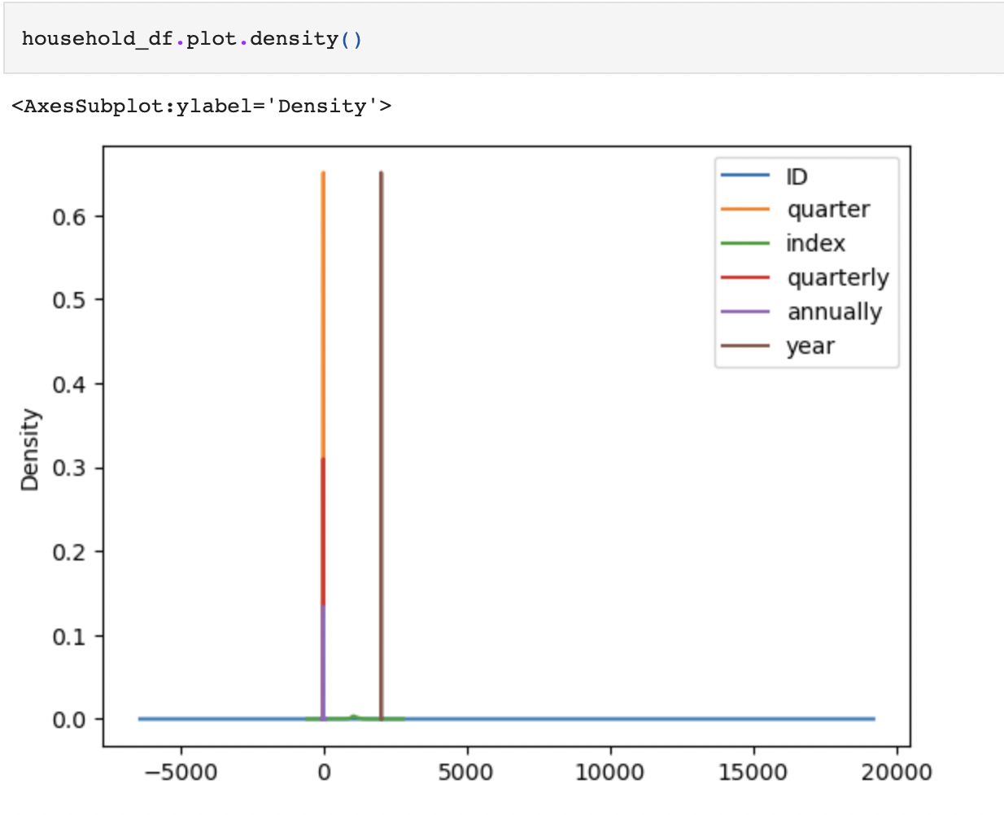
Machine Learning: Mock-Up Plot
1
2
Plotted density chart
4

Slide 18
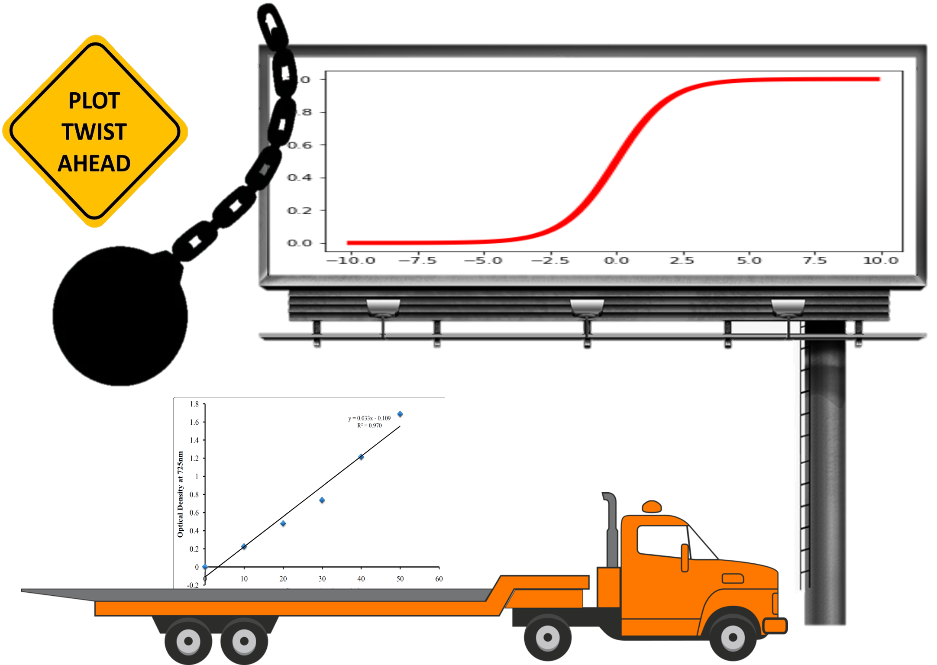
Machine Learning: Mock-Up Plot Twist
1
2
3
From the Mock-Up, it was understood that we needed to use Linear Regression instead of Logistical Regression to obtain our desired results

Slide 19
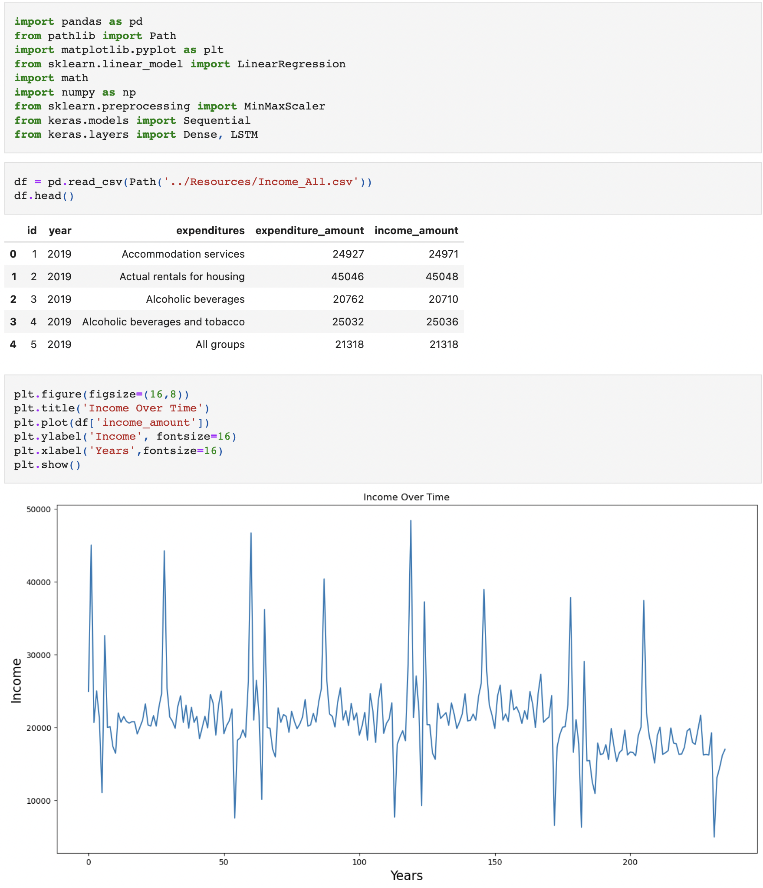
Machine Learning: Reading and Plotting Data
Imported dependencies and created our first graph to visualize the income amounts
2
3
4
5
6
7
8
9
10
11

Slide 20
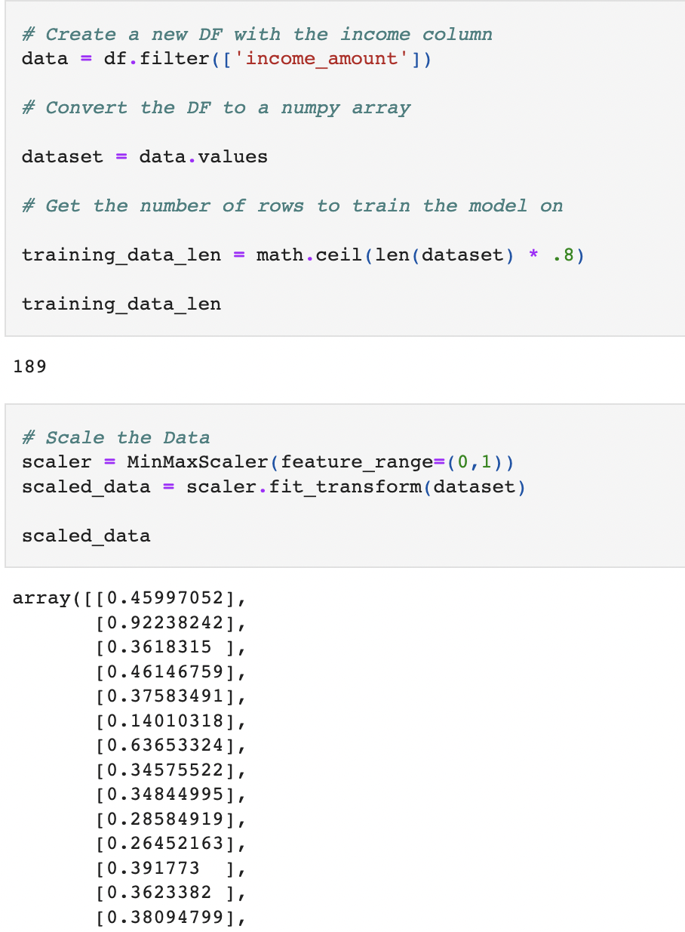
Machine Learning: Converting to an Array and Scaling the Data
1
We selected the income amount column to train the model and then used the MinMaxScaler to fit the values between 0 and 1
3
4
5
6
7
8
9
10
11

Slide 21
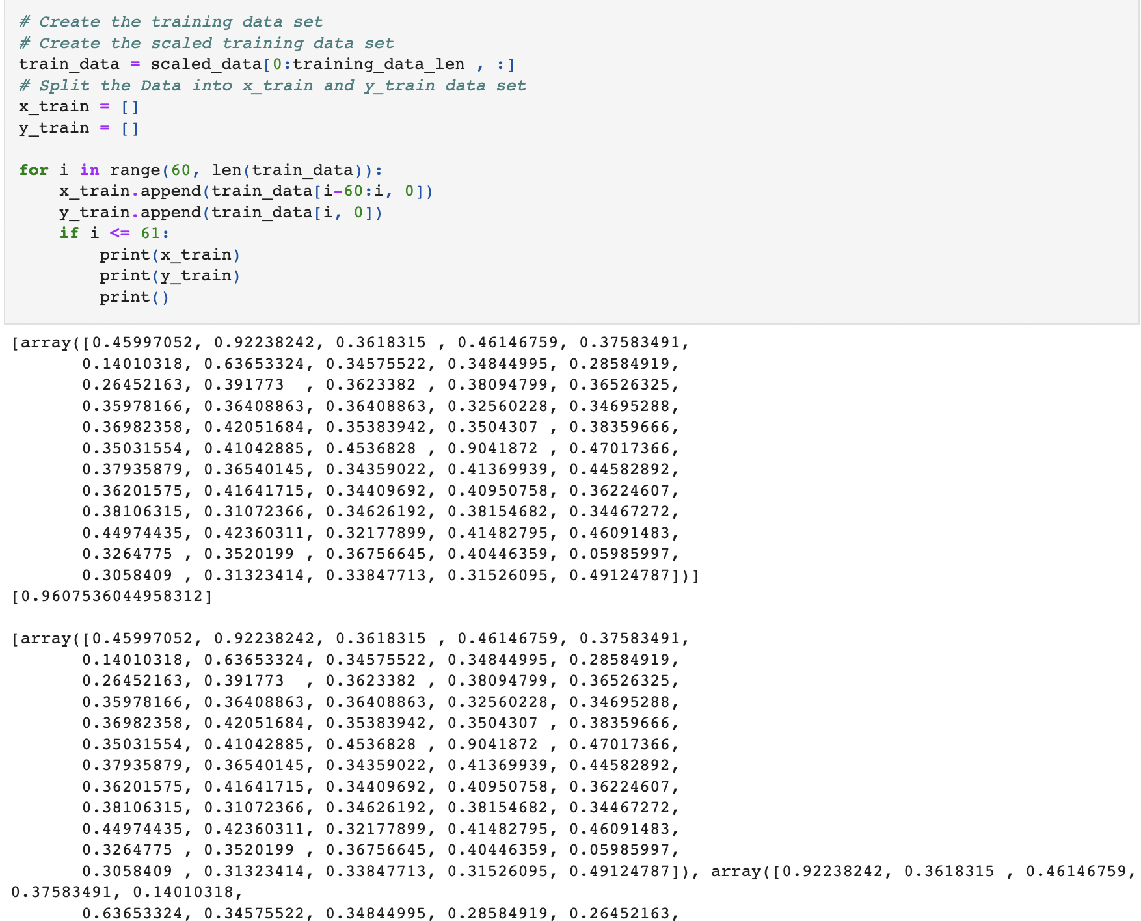
Machine Learning: Creating and Scaling the Training data set
1
2
Using the previous variable, we split the data into x and y_train to then create arrays for training our model
4
5
6
7
8
9
10
11

Slide 22
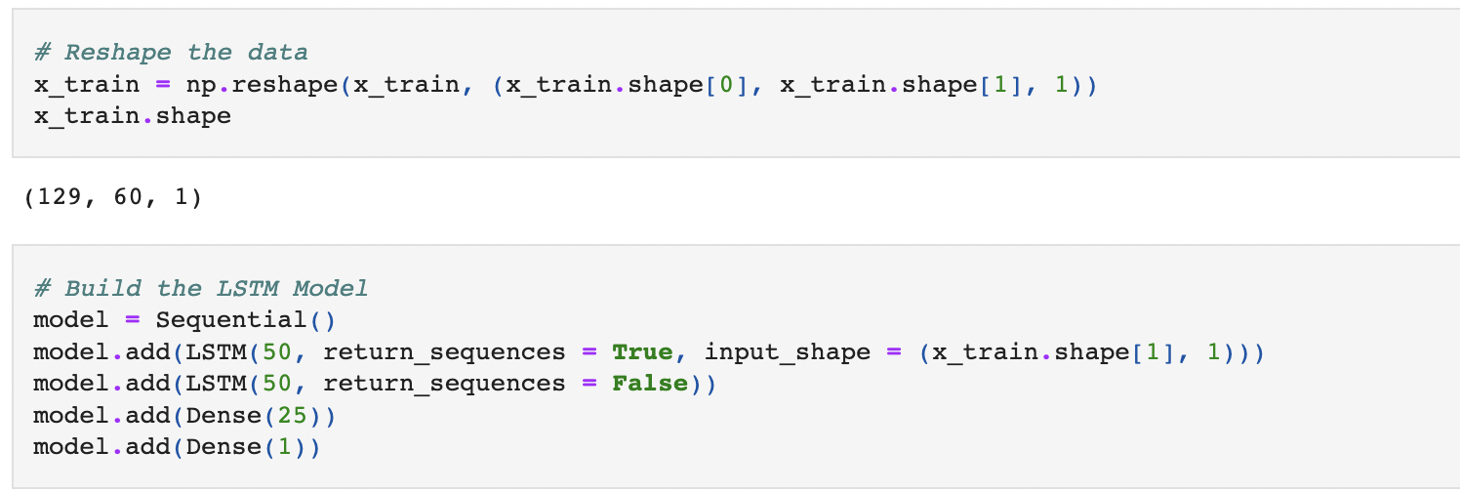
Machine Learning: Reshaping the data and building LSTM Model
1
2
3
Converted x_train and y_train data to numpy arrays and then reshaped the data to three dimensions to fit the LSTM model
5
6
7
8
9
10
11

Slide 23
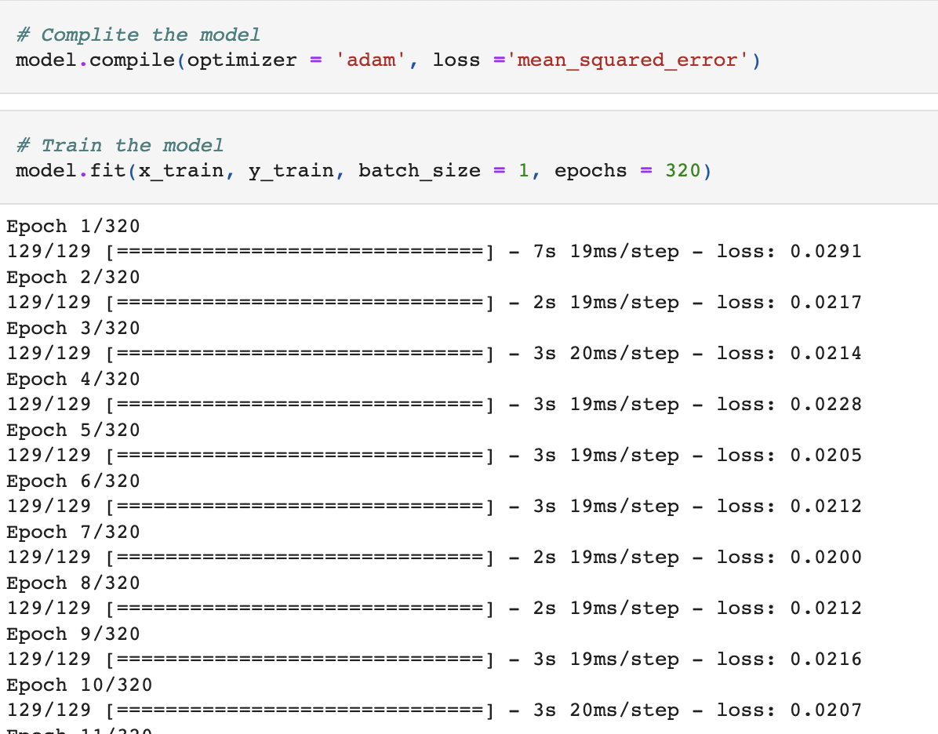
Machine Learning: Compile and Train the Model
1
2
3
4
Compile the model and trained it using 320 epochs [Why we chose 320?]
6
7
8
9
10
11

Slide 24
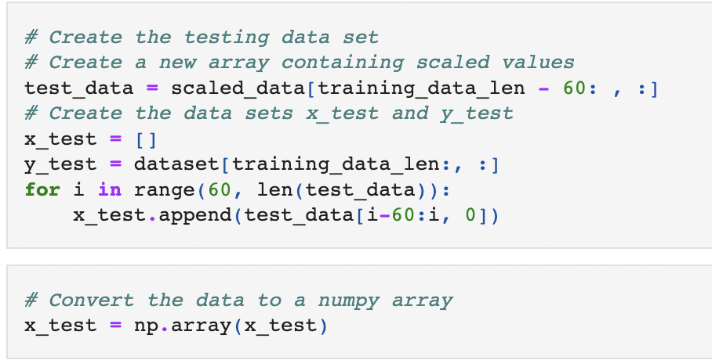
Machine Learning: Creating the Testing Data Set and Numpy Array
1
2
3
4
5
Created the x_test and y_test variables and converted them into numpy arrays
7
8
9
10
11

Slide 25
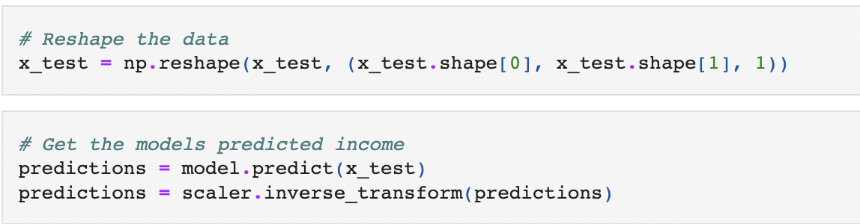
Machine Learning: Reshape the data and get predicted income
1
2
3
4
5
6
Reshaped the data then created the predictions variable to predict the income
8
9
10
11

Slide 26
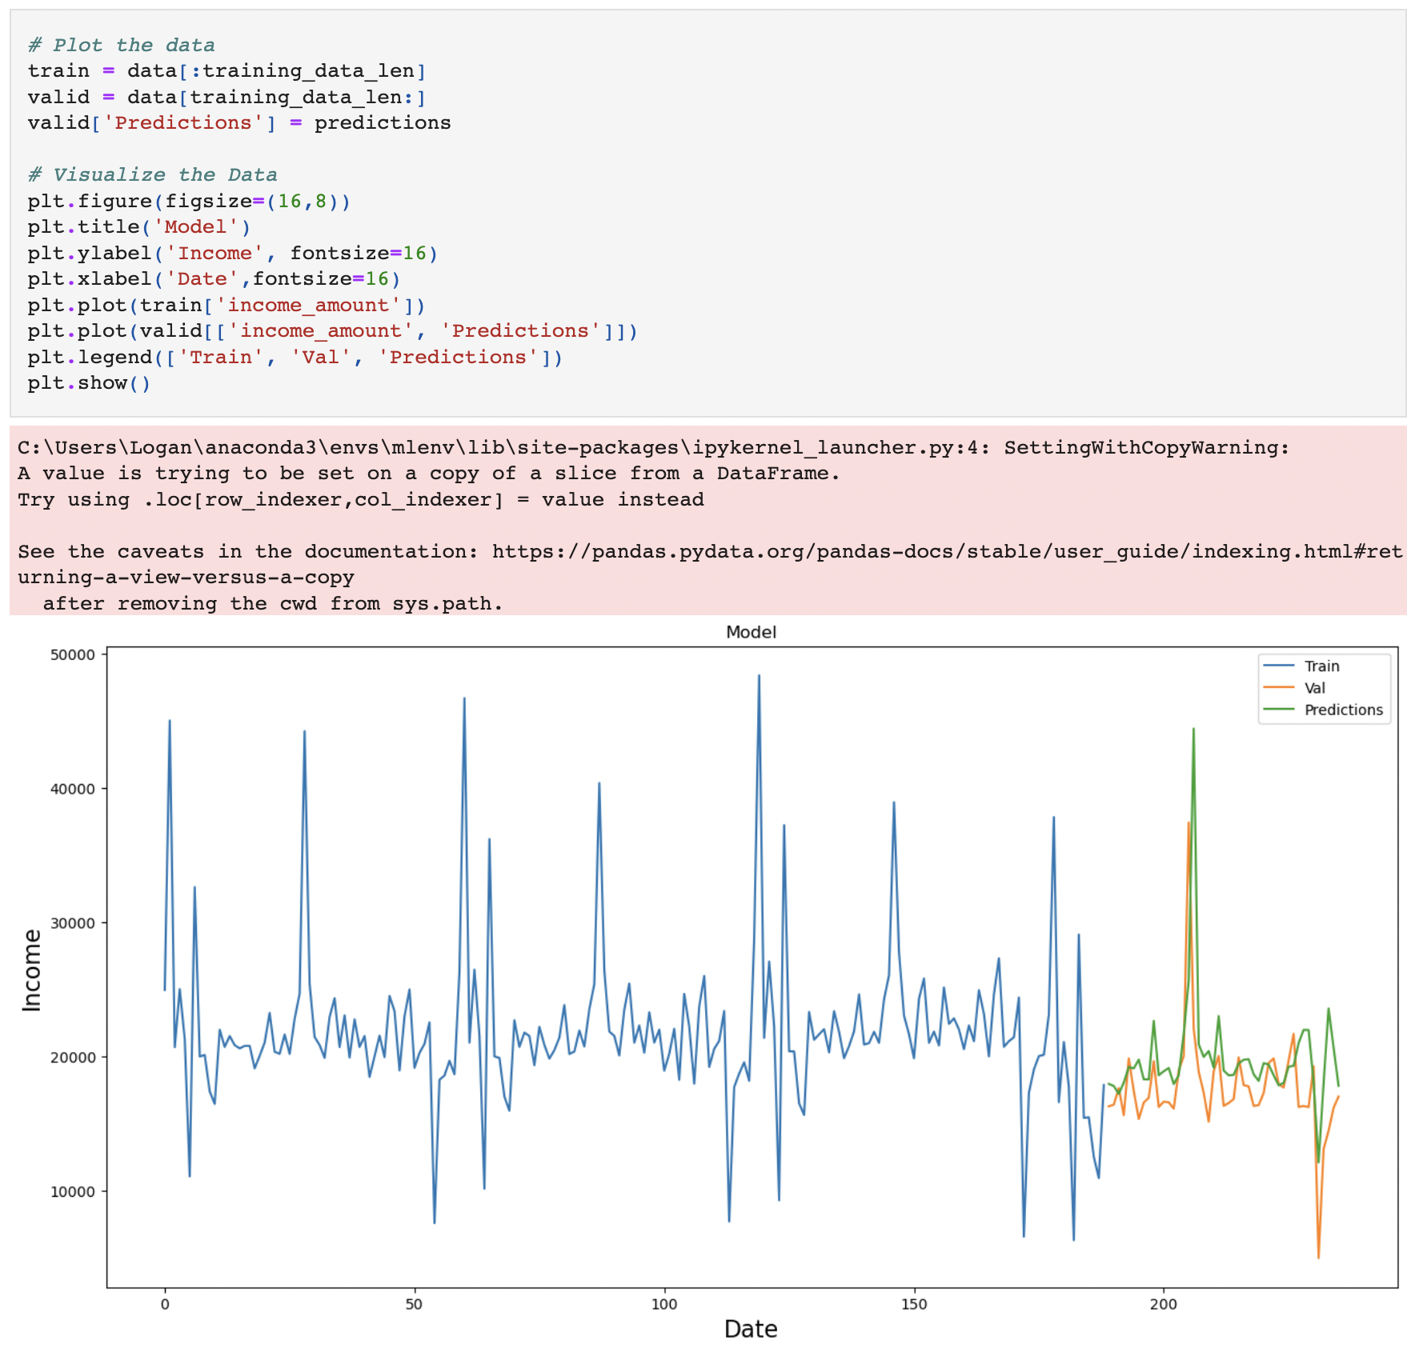
Machine Learning: Plot Results
1
2
3
4
5
6
7
Plotted our predictions, training data, and valid data
9
10
11

Slide 27
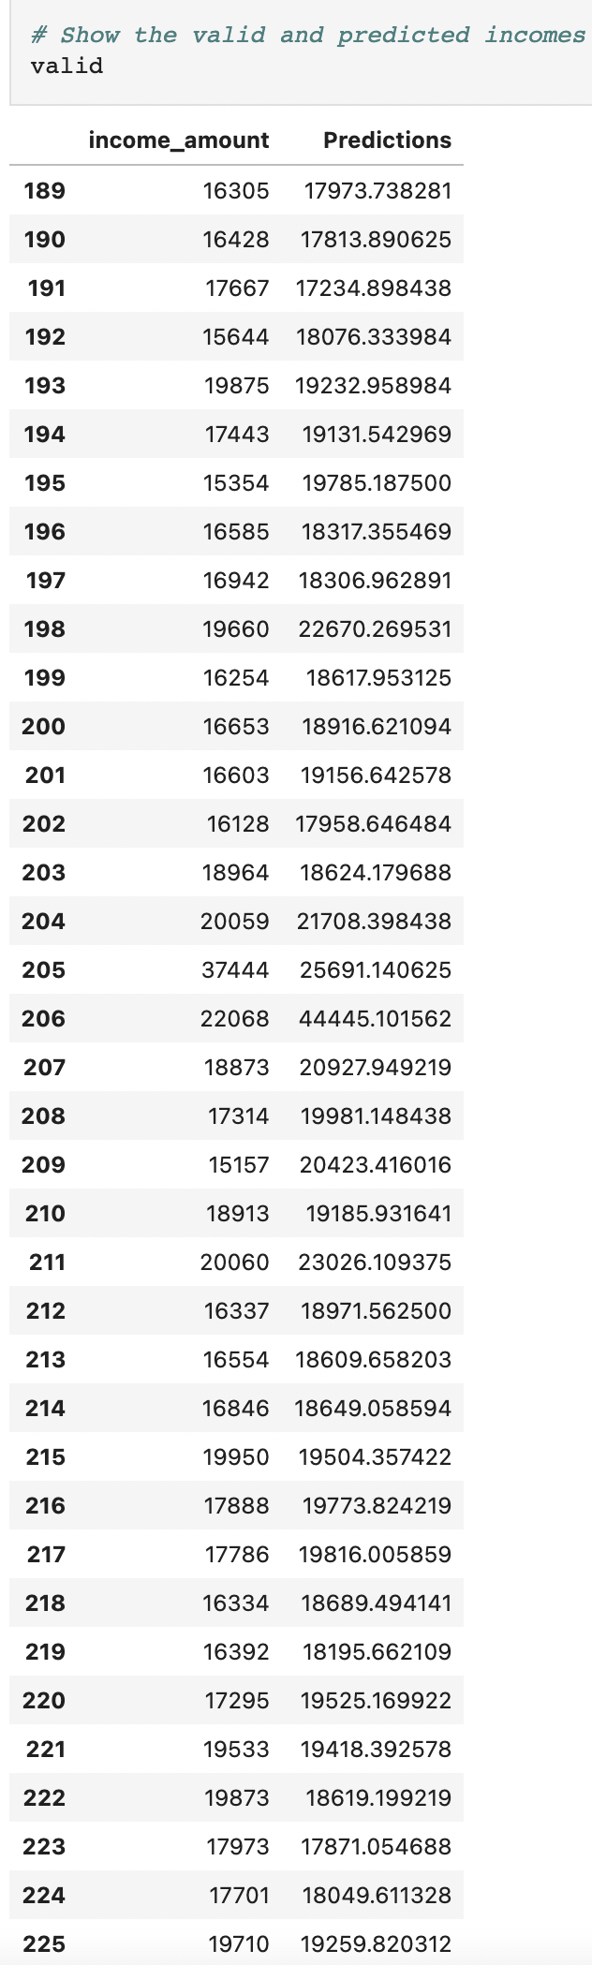
Machine Learning: Show Predicted and Actual Income
1
2
3
4
5
6
7
8
Data frame with the actual income amount versus what we predicted
10
11

Slide 28
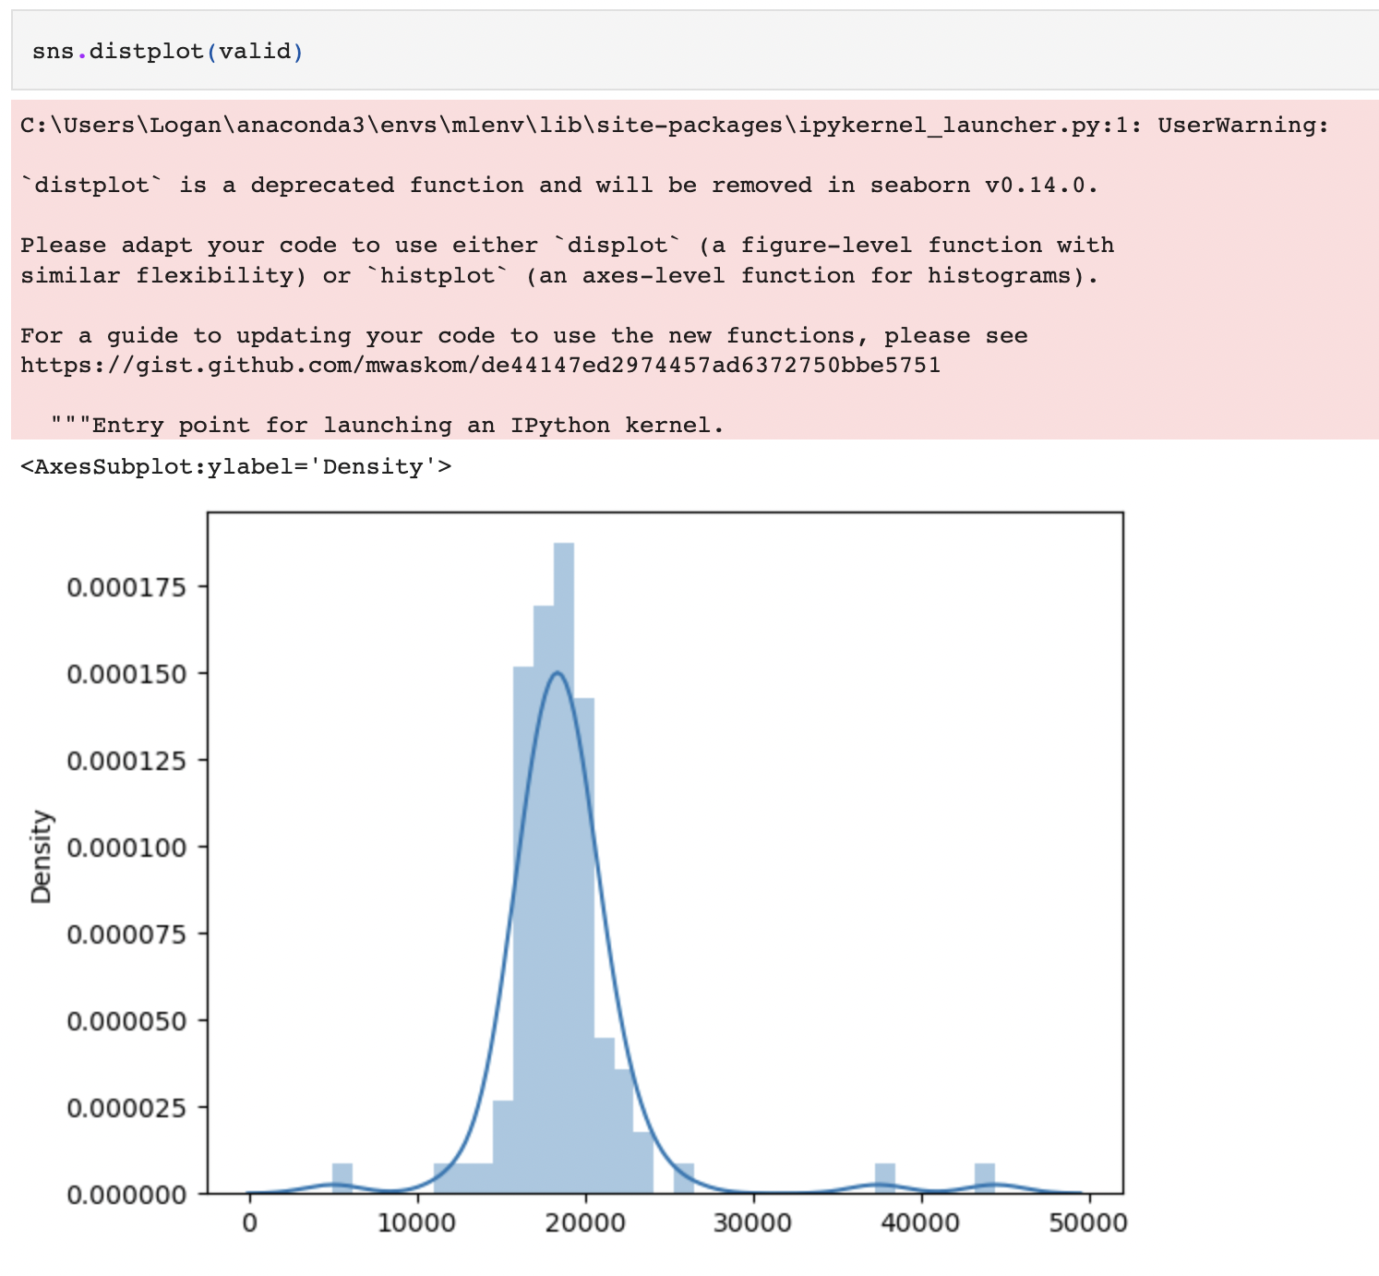
Machine Learning: Distplot Valid
1
2
3
4
5
6
7
8
9
Another plot showing the true income versus predictions [Most Accurate]
11

Slide 29
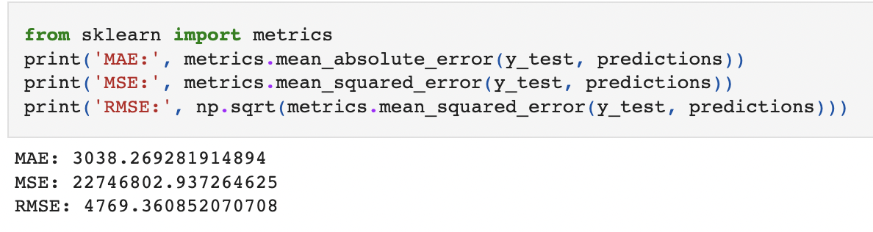
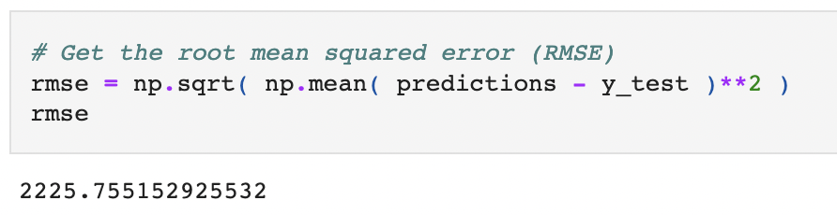
Machine Learning: Display Metrics
1
2
3
4
5
6
7
8
9
10
Displayed our MAE, MSE, and RMSE results

Slide 30
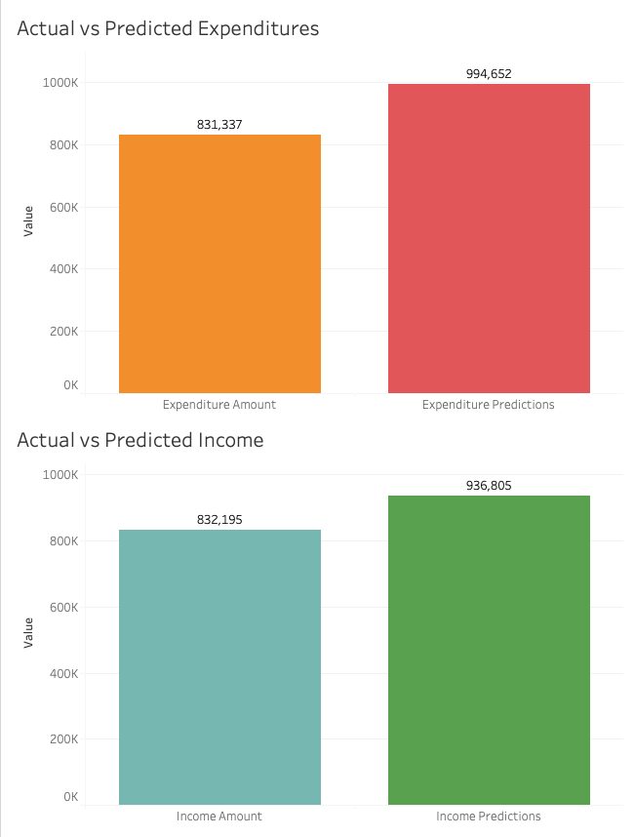
Tableau: Actual vs Predicted Results
Our model was close in predicting the actual results for 2022, but it could use some improvements
2
3
4
5

Slide 31
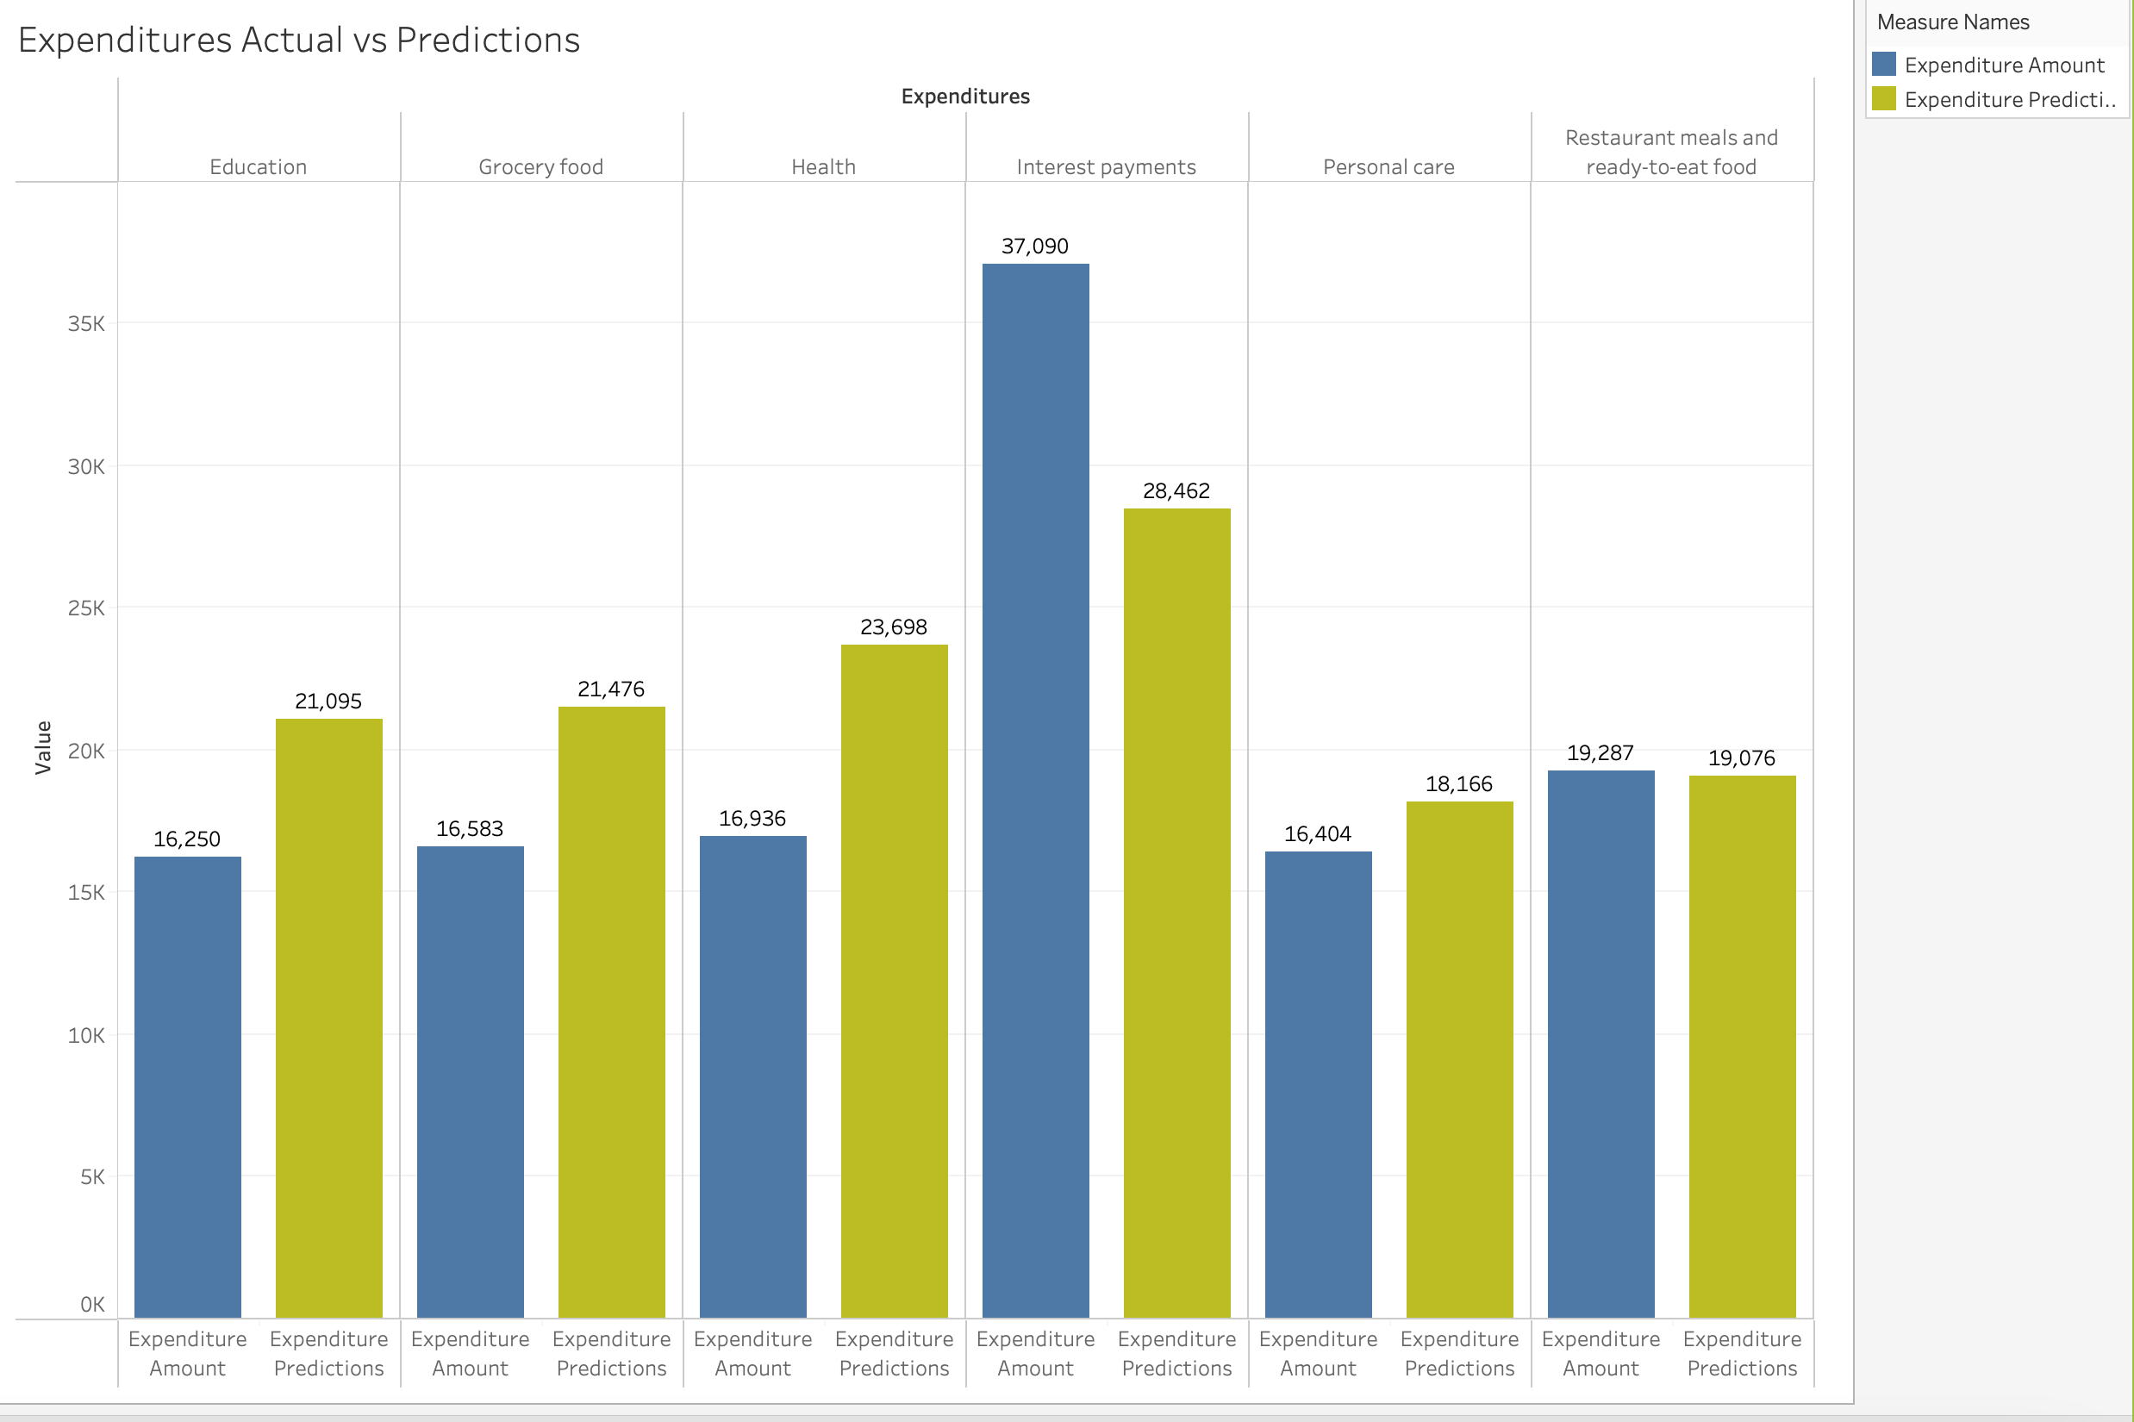
Tableau: Selected Expenditures Actual vs Predicted
1
Here are results for a few of the expenditures we analyzed
3
4
5

Slide 32
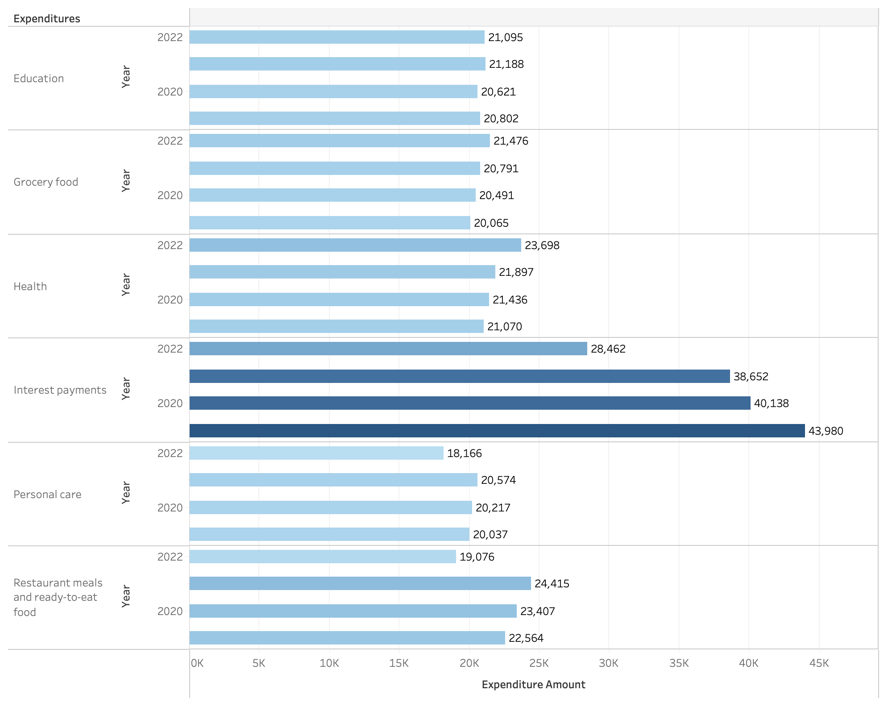
Tableau: Expenditure Predictions for 2022 vs Previous Years
1
2
There were various increases and decreases for the expenditure amounts
4
5

Slide 33
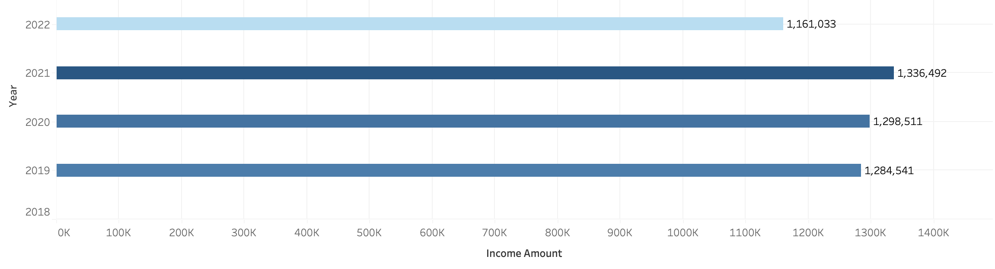
Tableau: Total Income Predictions for 2022 vs Previous Years
1
2
3
The 2022 income was predicted to decrease when compared to prior years
5

Slide 34
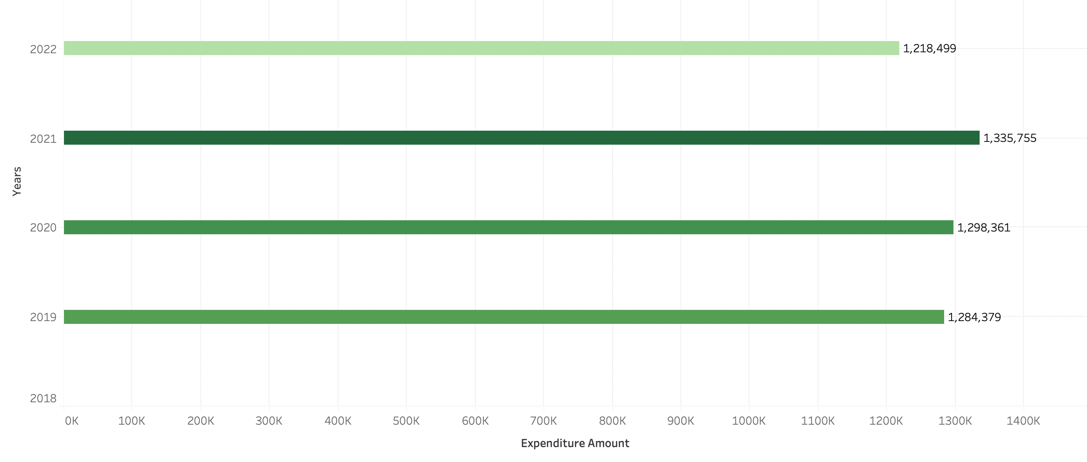
Tableau: Total Expenditure Predictions for 2022 vs Previous Years
1
2
3
4
The 2022 expenditures were predicted to decrease when compared to prior years

Slide 35
Results
What will the economy look like in one year? People will be making less money, which implies they will spend less on expenditures.
Will the income and the expenditures both increase? Both income and expenditures are projected to slightly decline.
Will our model accurately reflect the economy for 2022? Our model’s predictions for income and expenditures were slightly higher than the actual result.

Slide 36
Recommendations
If we had more time to plan, we could have chosen a Classification model which would have allowed us to group the Expenditures into specific categories.
From here, could have drawn even better insights and figured out what types of Expenditures are seeing the most changes on a year over year basis.
We could have also tried creating a budget which could illustrate adjustment consumers would need to make going into the next year.

